Slide 1
Interprocess Communication
Using pipes

Slide 2
Table of Contents
01
02
03
04
The Team
Description
The role of every member
Pseudo-code and description of the two sum functions
Tests
Answers
How the 2 tests were designed and why
Answer to the two questions with reason
Notes:
The role of every team member
Pseudo-code and description of the 2 sum functions
How the 2 tests were designed and why
Answers to the 2 questions with reasons

Slide 3
01
Team
Team Members and Roles

Slide 4
Team Members
Ahmed
Mohammed
Allaa
Notes:
Mohammed

Slide 5
02
Description
Pseudo-code and description of the two sum functions

Slide 6
Pseudocode-normal_sum
Sum = 0
Loop from i = 1 to n
Sum += i

Slide 7
Pseudocode-parallel_sum
Create a 2D array of pipes, each with their own file descriptors.
Loop over number of processes we want
Fork
If child:
Compute sum from in range
Write to parent
Exit once done
Increment l and r
Parent waits for children to execute
Sum = 0
Loop
Read subsum from each child
Sum += subsum

Slide 8
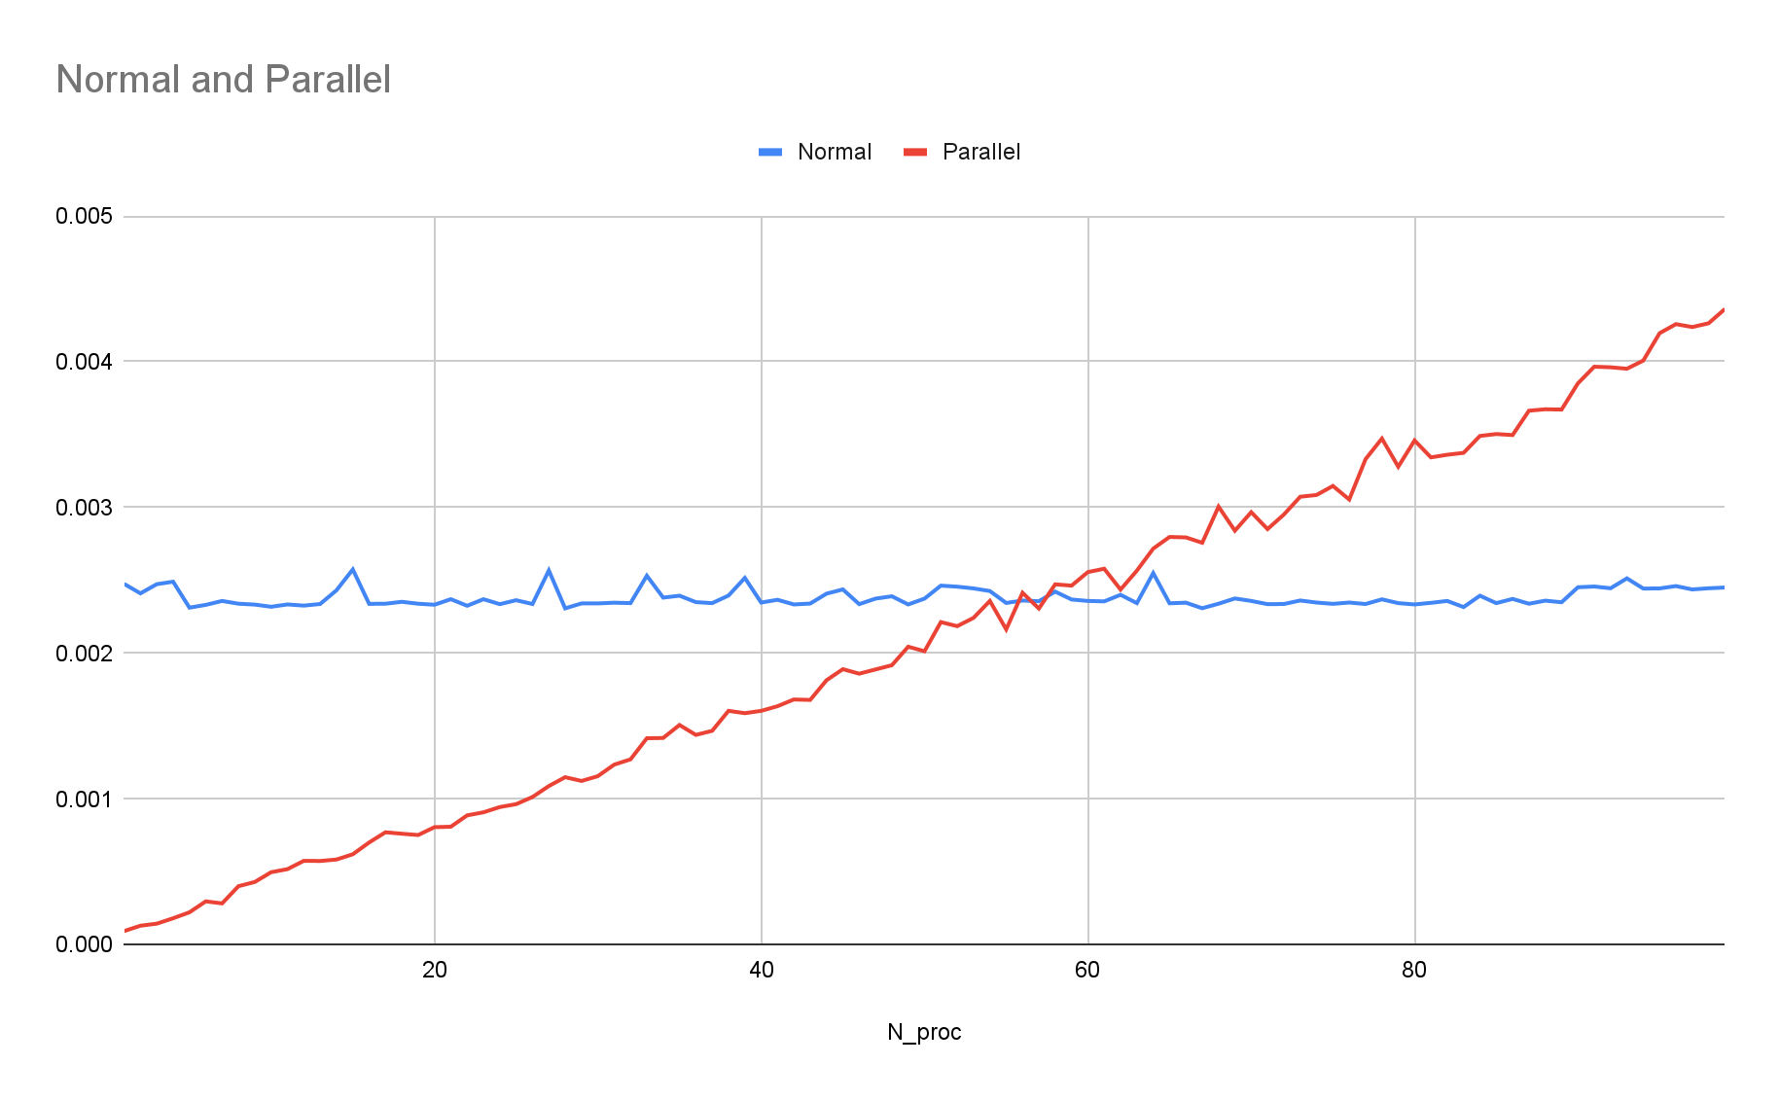
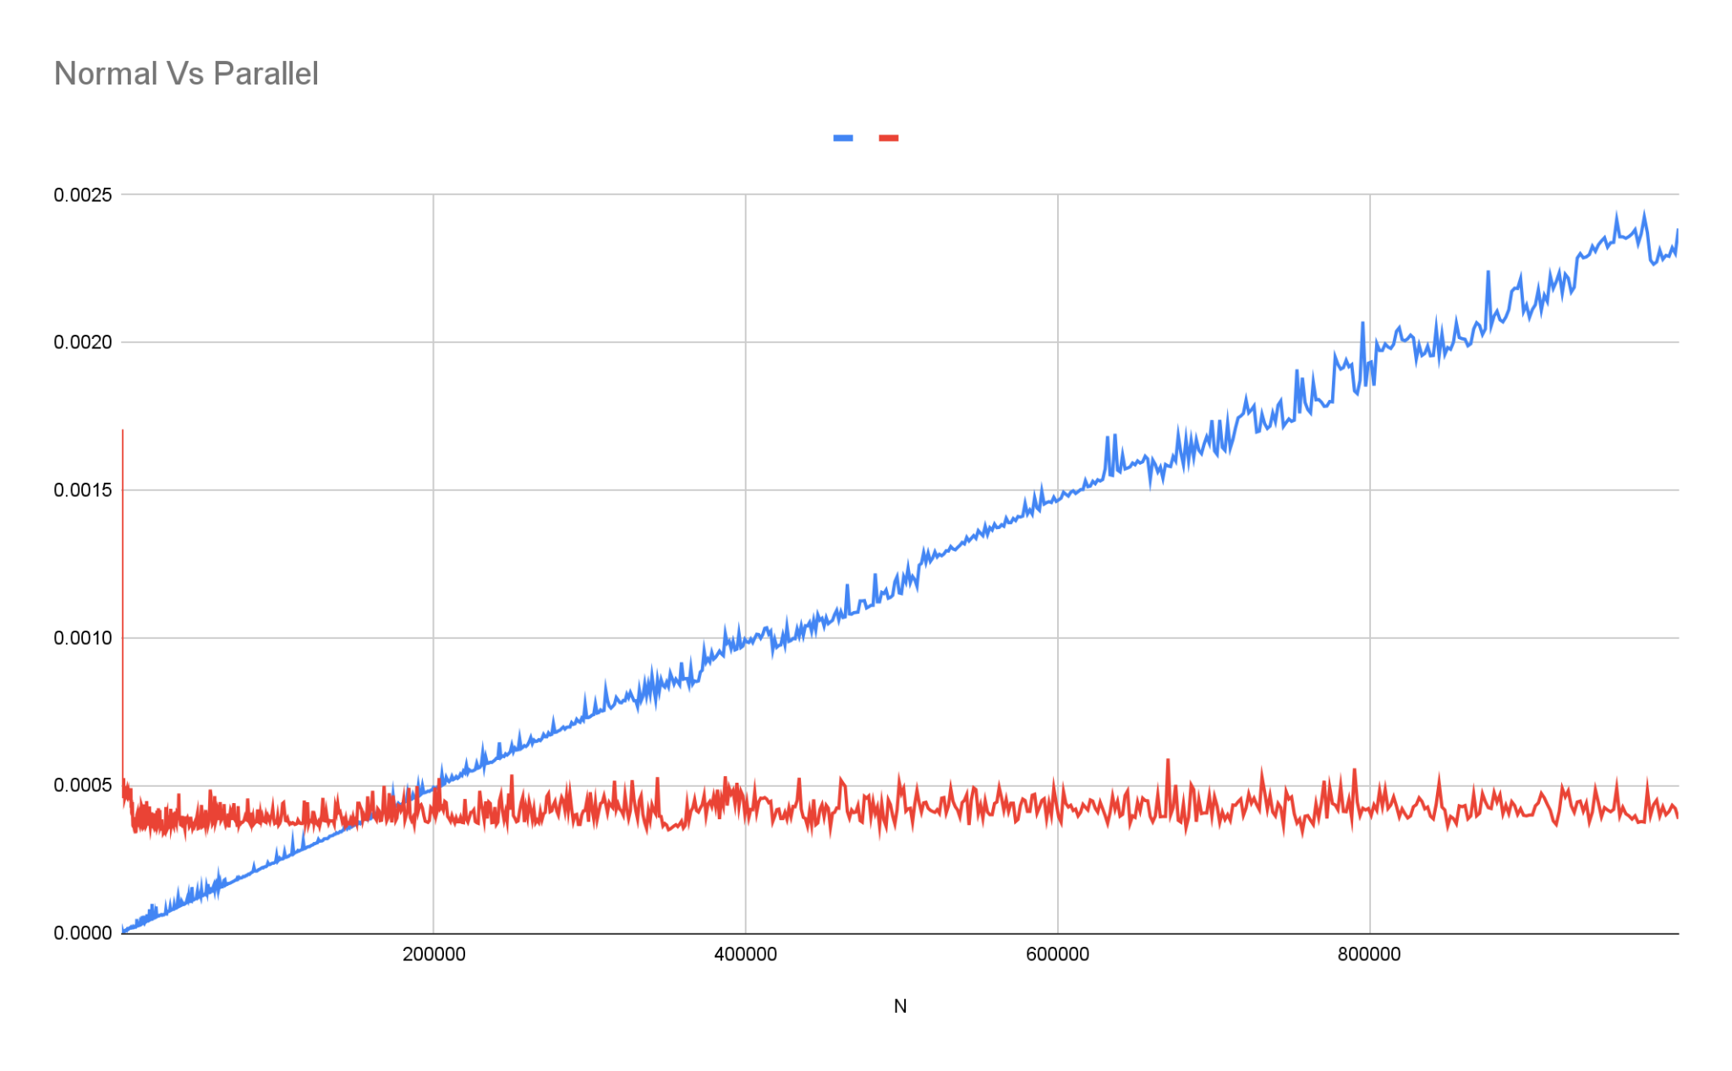
Graph

Slide 9
03
Tests
How were the the tests designed? Why?

Slide 10
Tests
Validation:We ran several tests to check output of the functions, we set a flag x to 0 if the output of the two sum functions are not matching and try it for different values of n_procs and i.
Varying N: We set n_procs = 10 and collect 999 data points where N = i * i for i = 1 && i < 1000. We plot the time taken for each function to finish executing.
Varying n_procs: We collect 99 samples here. We ran the tests on one of the machines in the system that used an i7-7600 which is a 4-core processor. We gave the parallel sum function values for n_procs between 1 and 99 inclusive and plot the time taken for each function to execute.

Slide 11
04
Questions
Answers and Explanations

Slide 12
Answers
If we fix n_proc, then at which value of N does parallel_sum outperform sum?
Fixing n_proc at 10, from the graph we can see that parallel_sum starts to outperform norma sum at around n ~ 170 000
If we fix N to a large number, then at which value of n_proc does parallel_sum outperform sum?
Fixing n at 1 000 000, from the graphs we find that parallel_sum outperforms sum for n_procs < 60.

